Slide 1
eBPF Hands On
Pranav, Ashwin, Rajneesh, Priyanka

Slide 2
Overview
What is eBPF
Trying some BCC tools
Writing your own eBPF code
eBPF Observability

Slide 3

Join the Slack Channel
#ebpf-handson-queries
https://github.com/ppnaik1890/eBPF-HandsOn

Slide 4
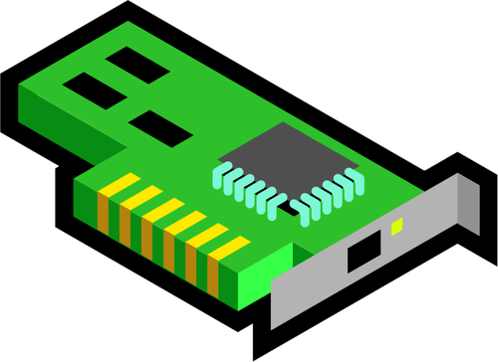
RX path: Packet arrives at the destination NIC
User space
Kernel space
Applications
NIC receives the packet
Match destination MAC address
Verify Ethernet checksum (FCS)
NIC driver
packet buffer
Packets accepted at the NIC
DMA the packet to RX ring buffer
NIC triggers an interrupt
TX
RX
packet buffer
Hardware interrupt
...
packet buffer
TX/RX rings
Circular queue
Shared between NIC and NIC driver
Content: Length + packet buffer pointer
NIC
Hardware
RX queue
Notes:
The NIC driver statically allocates the TX and RX ring buffers.
A ring is a circular queue where packets for TX/RX are stored.
Each slot in the ring stores the length and the physical address of the packet buffer. The packet buffer is stored in the kernel memory.
---
When the NIC receives the packet, it matches the destination with the set of acceptable MAC addresses, and validates ethernet checksum.
Let us look at the further processing of accepted packets
---
The NIC copies the packet to the memory location pointed by the RX ring slot, and updates the RX ring.
Direct Memory Access (DMA) is used for packet copy so that CPU time is not spent on packet copy.

Slide 5
Top Half and Bottom Half Packet Processing
CPU interrupts the process in execution
CPU initiates the bottom-half when it is free (soft-irq)
Switch from user space to kernel space
Switch from user space to kernel space
Driver dynamically allocates an sk-buff (a.k.a., skb)
Top-half interrupt processing
Lookup IDT (Interrupt Descriptor Table)
Call corresponding ISR (Interrupt Service Routine)
Acknowledge the interrupt
Schedule bottom-half processing
Switch back to user space
NIC driver processing
Driver dynamically allocates an sk-buff
Update sk-buff with packet metadata
Remove the Ethernet header
Pass sk-buff to the network stack
For all packets in buffer
Notes:
sk-

Slide 6
Application processing
User space
Kernel space
Application
On socket read:
Dequeue packet from socket receive queue (kernel space)
Copy packet to application buffer (user space)
Release sk-buff
Return back to the application
user space to kernel space
System calls
WQ
R
Q
Network stack
NIC driver
skb
packet buffer
TX
RX
packet buffer
Hardware interrupt
...
packet buffer
kernel space to user space
NIC

Slide 7
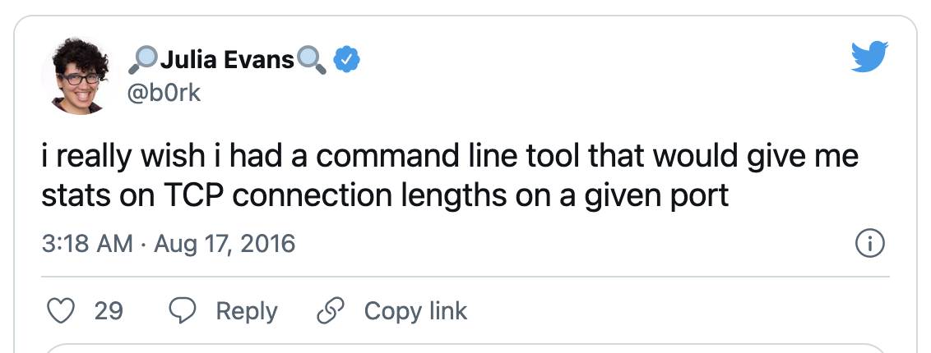
Why eBPF?
Understanding your system behaviour
Interpreting/modifying packets before it hits your application
Improving network performance
Source: https://blog.container-solutions.com/the-top-reasons-why-you-should-give-ebpf-a-chance

Slide 8
What is eBPF?

Slide 9
BPF: Berkeley Packet Filter
sudo tcpdump -p -ni eth0 -d "ip and udp"
BPF bytecode
(000) ldh [12]
(001) jeq #0x800 jt 2 jf 5
(002) ldb [23]
(003) jeq #0x11 jt 4 jf 5
(004) ret #65535
(005) ret #0
BPF bytecode invoked through Kernel APIs
sock = socket(PF_PACKET, SOCK_RAW, htons(ETH_P_ALL))
...
setsockopt(sock, SOL_SOCKET, SO_ATTACH_FILTER, ...)
https://blog.cloudflare.com/bpf-the-forgotten-bytecode/
Notes:
This program reads like this:
Load a half-word (2 bytes) from the packet at offset 12.
Check if the value is 0x0800, otherwise fail. This checks for the IP packet on top of an Ethernet frame.
Load byte from a packet at offset 23. That's the "protocol" field 9 bytes within an IP frame.
Check if the value is 0x11, which is the UDP protocol number, otherwise fail.
Return success. Packet is matching the rule.

Slide 10
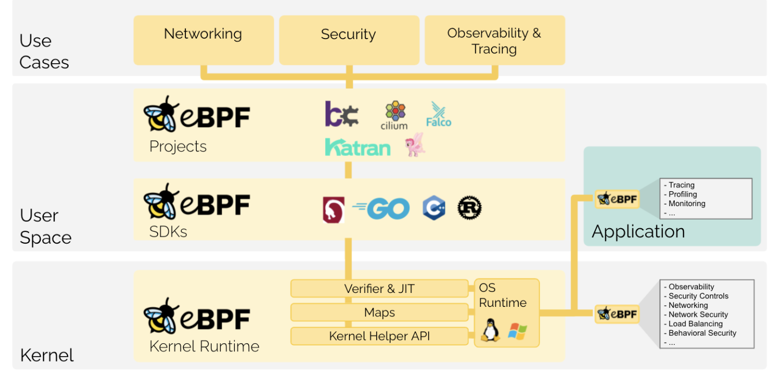
What is eBPF?
Extended BPF
Sandboxed programs (VM) in a privileged context inside kernel
Lets you program at various hook points
At runtime do more than filtering
Source: https://ebpf.io/what-is-ebpf/

Slide 11
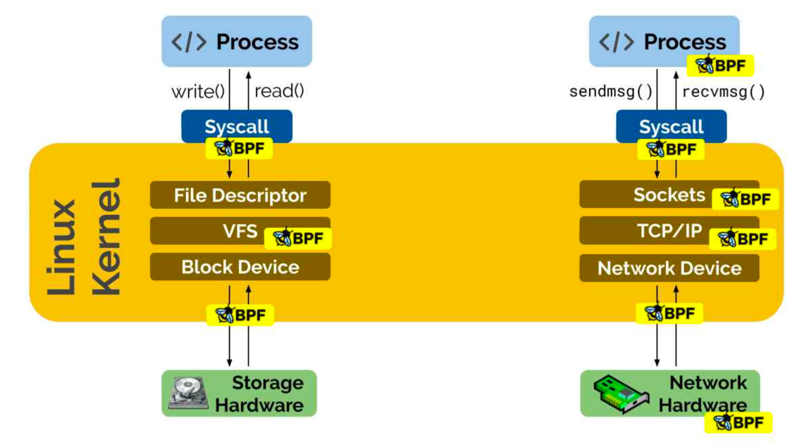
eBPF Hooks
Kernel functions (kprobes)
Userspace functions (uprobes)
System calls (fentry/fexit)
Network devices (tc/xdp)
Network routes
TCP congestion algorithms
Sockets (data level)

Slide 12
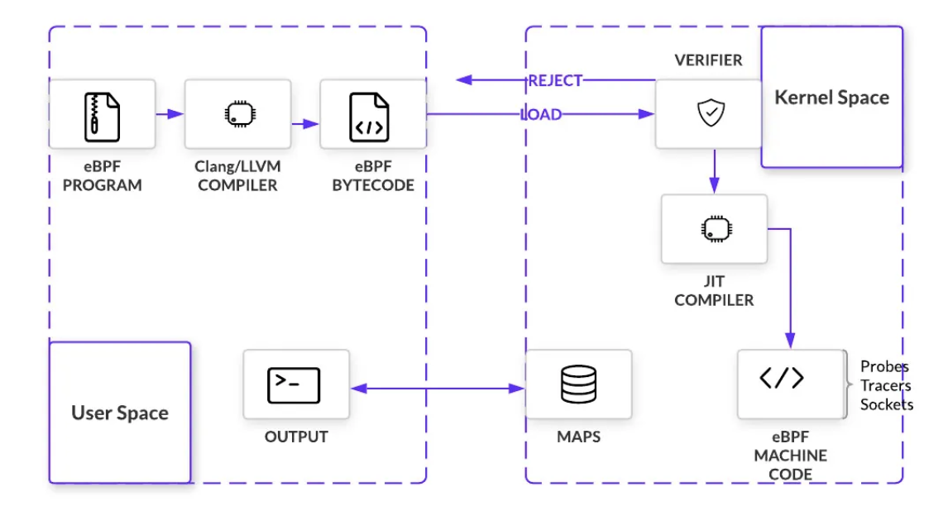
eBPF Architecture
the program does not loop
there are no unreachable instructions
every register and stack state is valid
registers with uninitialised content are not read
the program only accesses structures appropriate for its BPF program type
bcc, bpftrace
Runtime compilation
Share between userspace and kernel space
https://www.infoq.com/articles/gentle-linux-ebpf-introduction/
Notes:
https://cdn.open-nfp.org/media/documents/demystify-ebpf-jit-compiler.pdf https://www.infoq.com/articles/gentle-linux-ebpf-introduction/ After verification, eBPF bytecode is just-in-time (JIT) compiled into native machine code. eBPF has a modern design, meaning it has been upgraded to be 64-bit encoded with 11 total registers. This closely maps eBPF to hardware for x86_64, ARM, and arm64 architecture, amongst others. Fast compilation at runtime makes it possible for eBPF to remain performant even as it must first pass through a VM.

Slide 13
eBPF Toolchains
bcc:
python programs with embedded eBPF programs
system profiling/tracing
Bpftrace:
high-level tracing language for eBPF
bpftrace uses LLVM as a backend
Uses bcc for kernel interaction
Inspired by DTrace and SystemTap
eBPF Go library:
clang/LLVM compiler
Libbpf
C/C++-based generic eBPF library
library APIs for applications

Slide 14
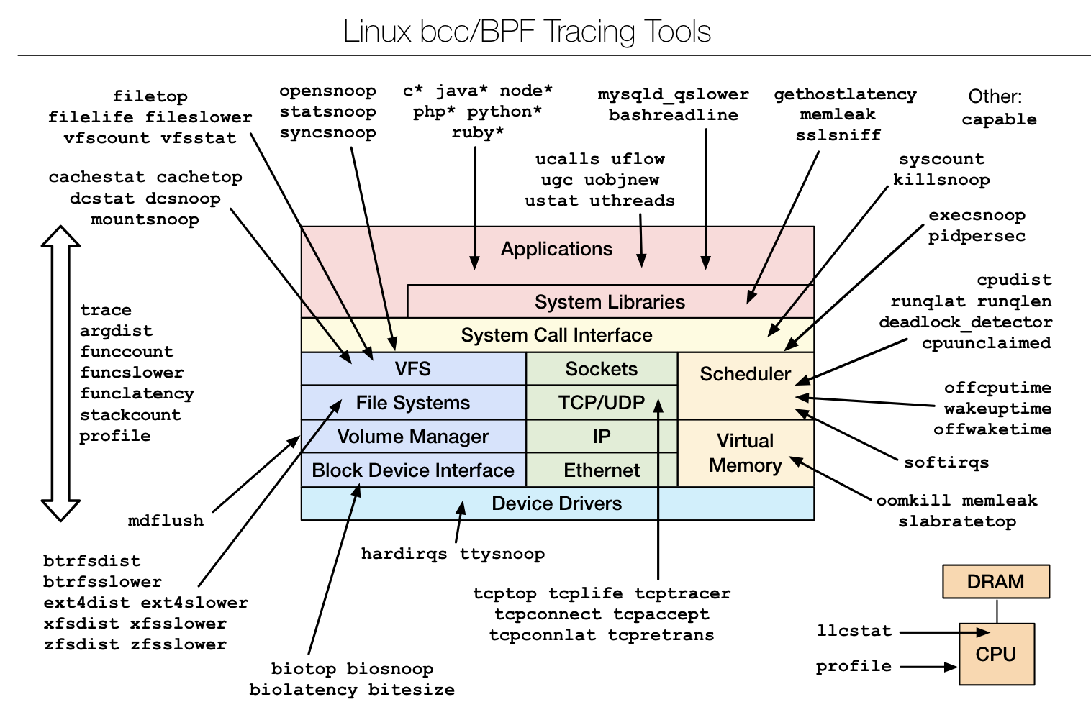
eBPF bcc monitoring/tracing
eBPF Toolkit for tracing and program manipulation
requires Linux 4.1 and above
C wrapper around LLVM
Front-ends in Python and lua
https://github.com/iovisor/bcc

Slide 15
Let’s try bcc tools!
Notes:
Bcc is a toolkit which is used for creating efficient kernel tracing programs built upon ebpf. First, it eases the task of writing ebpf programs for kernel instrumentation, and then it exposes a python front end by which we can attach these ebpf programs on various kernel routines inside the linux kernel.
syscount
execsnoop Trace new processes via exec() syscalls.
Summarize syscall counts and latencies.
Cachestat: monitor page cache access

Slide 16
Writing your own eBPF code

Slide 17
Background
XDP (Express Data Path)
libbpf
eBPF data structures

Slide 18
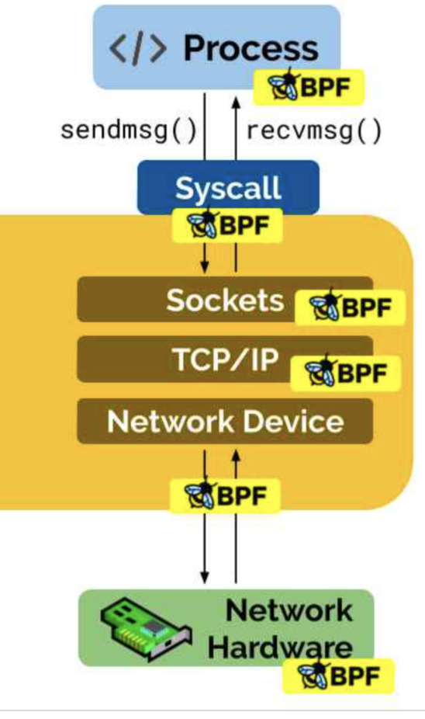
eXpress Data Path (XDP)
Attach an eBPF program to a lower-level hook
Implemented by network device drivers
Runs after network device drivers (before the skb is allocated)
XDP Modes
Generic XDP : XDP programs are loaded into the kernel. (No specific hardware support required)
Native XDP: The XDP program is loaded by the network card driver
Offloaded XDP: The XDP program loads directly on the NIC
https://www.tigera.io/learn/guides/ebpf/ebpf-xdp/
Notes:
https://www.tigera.io/learn/guides/ebpf/ebpf-xdp/

Slide 19
XDP Operations
XDP_DROP – Drops and does not process the packet
XDP_PASS – Indicates that the packet should be forwarded to the normal network stack
XDP_TX – Forwards the packet (which may have been modified) to the same network interface
XDP_REDIRECT – Bypasses the normal network stack and redirects the packet via another NIC

Slide 20
XDP or TC
XDP hook is earlier, hence faster performance
XDP is better for complete packet rewrites
tc/ebpf and xdp as complementary programs
tc/eBPF programs on ingress and egress, XDP is ingress only
tc/BPF does not require HW driver changes, XDP typically uses native driver mode for best performance
https://liuhangbin.netlify.app/post/ebpf-and-xdp/

Slide 21
libBPF
Library to build eBPF applications
Usually used alongside BPF CO-RE (compile once, run everywhere).
Includes BTF (BPF Type Format)
encode metadata data types, function info, and line info
Libbpf acts as a BPF program loader
‍Open Phase: Maps, variables, and global variables are discovered
‍Load Phase: Maps are created. BPF programs are loaded into the kernel and verified
‍Attachment Phase: BPF programs are attached to hooks
‍Tear Down Phase: Resources are freed as BPF programs are detached and unloaded from the kernel
https://www.containiq.com/post/libbpf
Notes:
https://www.containiq.com/post/btf-bpf-type-format
https://www.containiq.com/post/libbpf

Slide 22
eBPF Maps
Pass data between kernel space and user space
Create map parameters
Functions:
bpf(BPF_MAP_CREATE, &bpf_attr, sizeof(bpf_attr));
union bpf_attr {
struct { /* anonymous struct used by BPF_MAP_CREATE command */
__u32 map_type; /* one of enum bpf_map_type */
__u32 key_size; /* size of key in bytes */
__u32 value_size; /* size of value in bytes */
__u32 max_entries; /* max number of entries in a map */
__u32 map_flags; /* prealloc or not */
};
}
void bpf_map_lookup_elem(map, void *key. ...);
void bpf_map_update_elem(map, void *key, ..., __u64 flags);
void bpf_map_delete_elem(map, void *key);

Slide 23
eBPF Map types
libbpf/include/uapi/linux/bpf.h
BPF_MAP_TYPE_UNSPEC
BPF_MAP_TYPE_HASH
BPF_MAP_TYPE_ARRAY
BPF_MAP_TYPE_PROG_ARRAY
BPF_MAP_TYPE_PERF_EVENT_ARRAY
BPF_MAP_TYPE_PERCPU_HASH
BPF_MAP_TYPE_PERCPU_ARRAY
BPF_MAP_TYPE_STACK_TRACE
BPF_MAP_TYPE_CGROUP_ARRAY
BPF_MAP_TYPE_LRU_HASH
BPF_MAP_TYPE_LRU_PERCPU_HASH
BPF_MAP_TYPE_LPM_TRIE
BPF_MAP_TYPE_ARRAY_OF_MAPS
BPF_MAP_TYPE_HASH_OF_MAPS
BPF_MAP_TYPE_DEVMAP
BPF_MAP_TYPE_SOCKMAP
BPF_MAP_TYPE_CPUMAP
BPF_MAP_TYPE_XSKMAP
BPF_MAP_TYPE_SOCKHASH
BPF_MAP_TYPE_CGROUP_STORAGE
BPF_MAP_TYPE_REUSEPORT_SOCKARRAY
BPF_MAP_TYPE_PERCPU_CGROUP_STORAGE
BPF_MAP_TYPE_QUEUE
BPF_MAP_TYPE_STACK
BPF_MAP_TYPE_SK_STORAGE
BPF_MAP_TYPE_DEVMAP_HASH
BPF_MAP_TYPE_STRUCT_OPS
BPF_MAP_TYPE_RINGBUF
BPF_MAP_TYPE_INODE_STORAGE
BPF_MAP_TYPE_TASK_STORAGE
BPF_MAP_TYPE_BLOOM_FILTER

Slide 24
Code Overview
https://github.com/ppnaik1890/eBPF-HandsOn
Two examples
tut01: Drop all ssh traffic
tut02: Leverage the above and learn about ebpf maps (count the no.of dropped packets)
Run on:
VM: pre-installed packages
baremetal (your machine): manual setup

Slide 25
Code Exercise
Write an XDP program which stores and maintains the list of remote TCP ports with which your system interacts with and then write a user program to display the list of those TCP ports
Hints:
Write an XDP program to parse source ports of incoming packet and store distinct source ports in an eBPF map.
Write a user program to load and attach the XDP program and then read distinct source ports from the eBPF map.

Slide 26
What’s More - BPF tail calls
Mechanism that allows one BPF program to call another, without returning back to the old program.
Uses the same stack frame leading to minimal overheads.
Only programs of the same type can be tail called.
User space program populates a special map of type BPF_MAP_TYPE_PROG_ARRAY
File descriptors of various BPF programs to be tail called are store in the map by a user space program
bpf_tail_call() is a helper used inside of a BPF program to make the switch to another BPF program by passing a map of type specified above and a key.
Notes:
There are other functionalities that are supported in eBPF which we’ll talk about now.
BPF tail call is a mechanism which allows an eBPF program to call or jump into another eBPF program without ever returning back to the ebpf program that made the call.
BPF tail calls allow us to write more modular code with each ebpf program handling a single logical module.
This functionality is implemented via a long jump and unlike a function call this can be done using the same stack frame and hence the overheads of a tail call are minimal.
Only programs of the same type can be tail called which means that an XDP program can only call into another XDP program and not some other type of BPF program
Now, we move onto how it works, first a user space program populates a map of type BPF_MAP_TYPE_PROG_ARRAY which contains references to various BPF programs which are to be chained
Finally, a helper function bpf_tail_call is inside a BPF program to initiate a tail call by passing a key and the map that was populated by the user space program

Slide 27
What’s more - Redirecting packets to CPU cores
Packets can be redirected to different CPU cores at XDP for further network stack processing.
A user space program populates a map of type BPF_MAP_TYPE_CPUMAP which contains references to CPUs to which the packet is to be redirected.
The helper bpf_redirect_map() takes in a reference to a map of type BPF_MAP_TYPE_CPUMAP, and a key.
The helper is used in the XDP program to redirect raw packets to CPU cores for further processing.

Slide 28
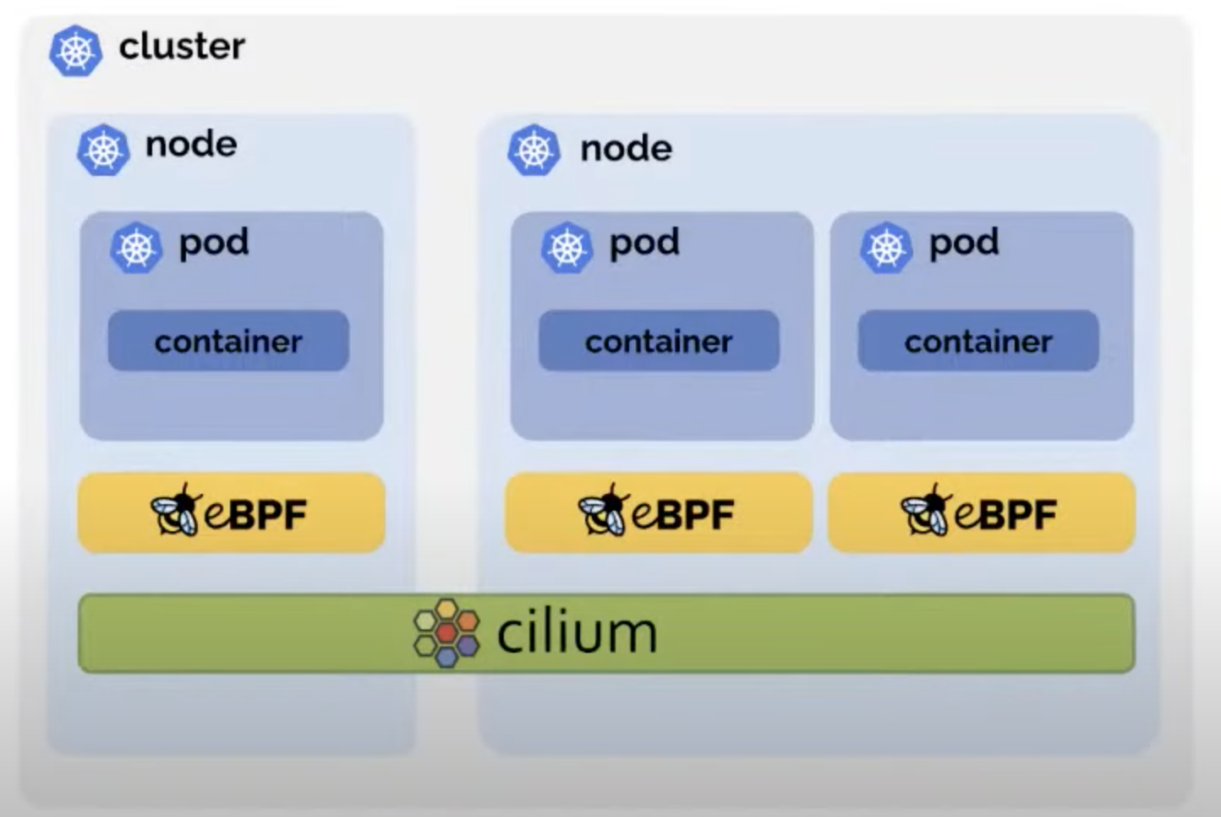
eBPF Observability
Cilium
Agent on each node
Tunneling or direct routing
Kube-proxy replacement
Source: https://www.youtube.com/watch?v=yQoVOumoY5k&ab_channel=Civo

Slide 29
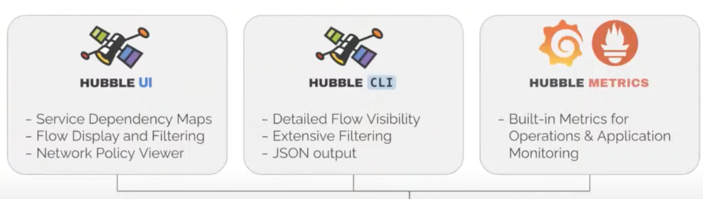
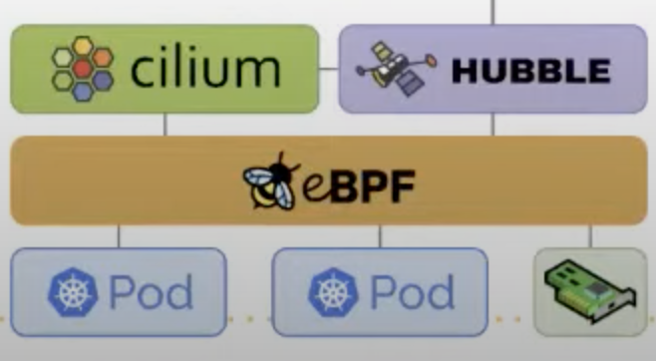
eBPF Observability
Cilium: Hubble
Source: https://www.youtube.com/watch?v=yQoVOumoY5k&ab_channel=Civo

Slide 30
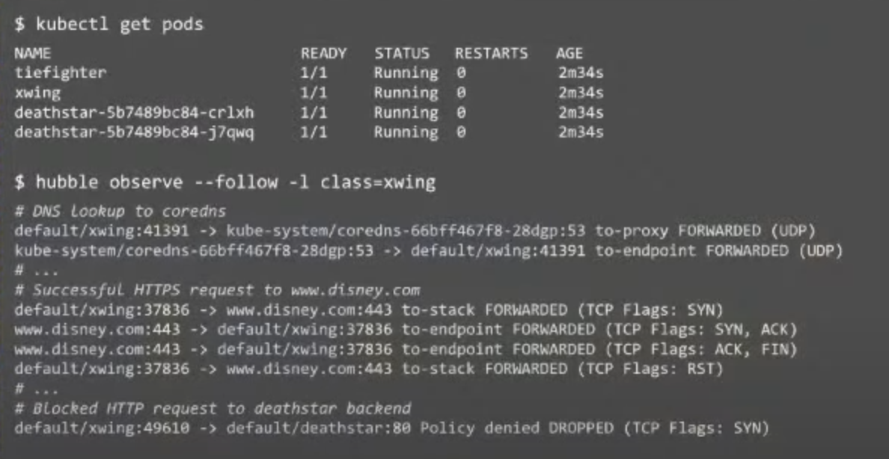
eBPF Observability
Cilium: Hubble
Source: https://www.youtube.com/watch?v=yQoVOumoY5k&ab_channel=Civo

Slide 31
Future References
https://github.com/xdp-project/xdp-tutorial/
https://github.com/iovisor/bcc
https://www.brendangregg.com/ebpf.html
https://ebpf.io/slack

